Slide 1

Add title here
Add subtitle here
Notes:
We created this PowerPoint to be both a complete resource and a template. You will notice in the notes that a complete script is there.
Feel free to edit this slide show. Some slides have repetitive information, showing the same information in a different way. (For example, if we have a video slide, we also have a non-video slide showing the same thing.) We recommend you trim the repetitive slides based on which ones will work best for your audience and your setup.
You will also notice that the options under “new slide” are already formatted to fit the stylistic theme of the slide show, so you can add your own or remove slides, depending on your and your audience’s needs, as well as any current events that you may wish to include.
If you want to add photos from Palestine, ActiveStills.org has a large library of photos that are free to use, crediting them as the source.
One note about formatting. Rather than using the animation function to make text or pictures appear on the slide, we created the same effect by including multiple slides that build upon each other the same topic. We did this to make it easier to share and ensure continuity on different computer programs.
If you do not use any text boxes that allow you to “add title/text here,” you can delete those before making your presentation
OPENING TEXT
The Apartheid-Free initiative seeks to address the root causes of Palestinian oppression
Based on Palestinian calls for freedom, justice and equality
And their specific asks of the international community to name apartheid and create “Apartheid-Free Zones”
For Christian communities – this work is also rooted in a Kairos Palestine and Global Kairos for Justice’s: A Dossier on Israeli apartheid

Slide 2
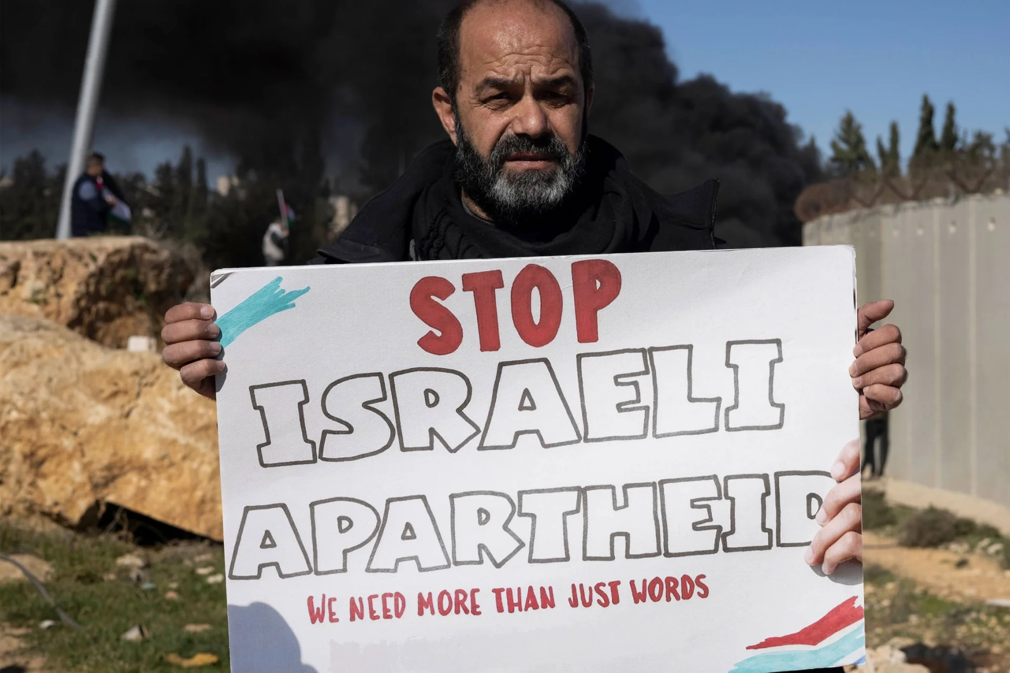
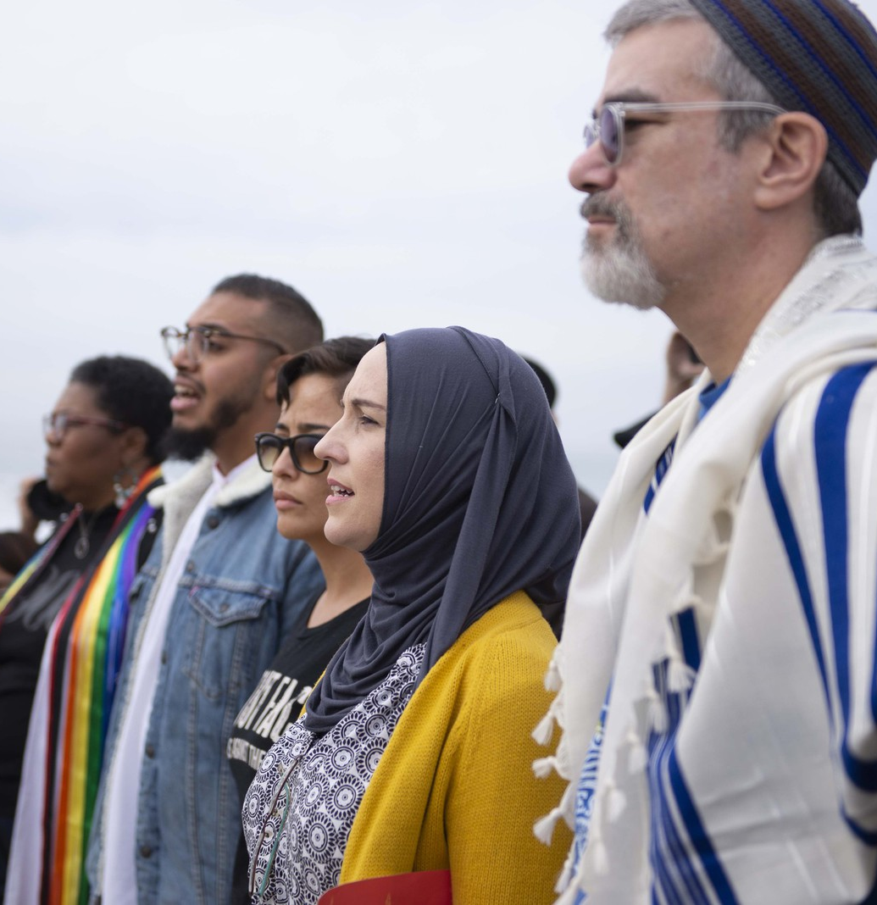
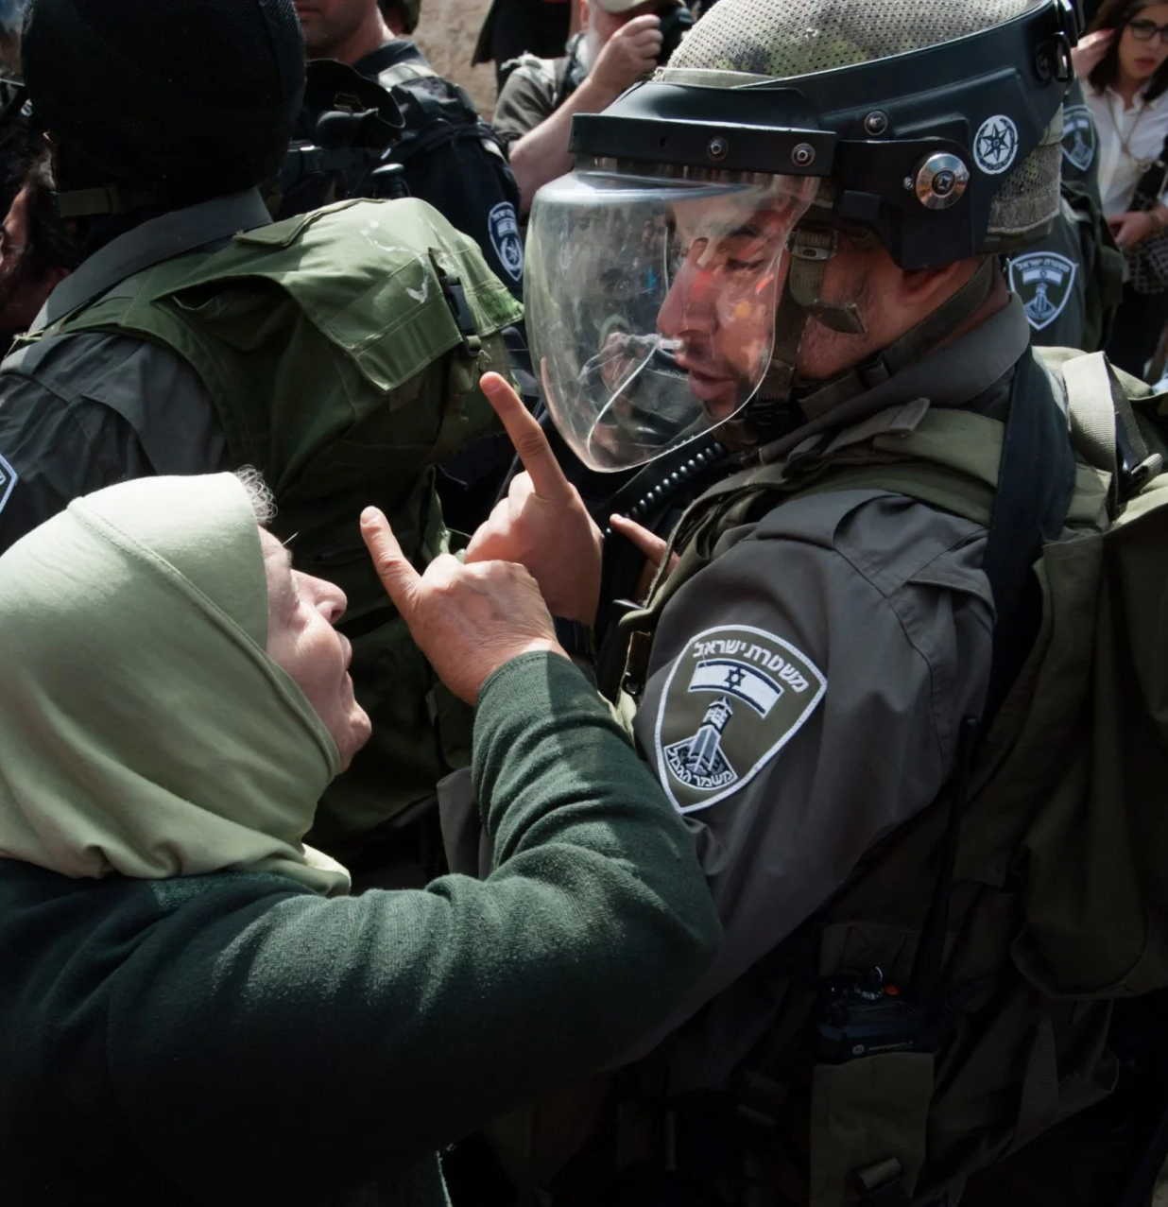
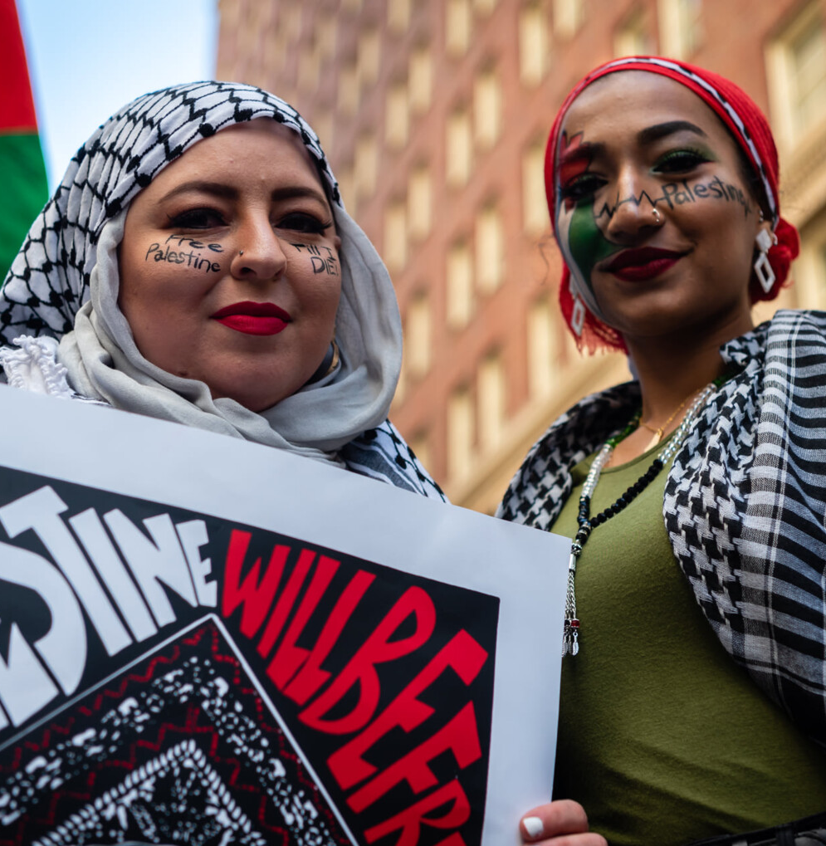
AGENDA
Apartheid Explained
The Pledge
Take Action
Q&A
What are Apartheid-Free Communities?
Educate ourselves, our community and sign the pledge.
Discussion, questions and next steps.
What is an apartheid state?
Notes:
Here is what we will go over today:
What is an apartheid state?
What is the Apartheid Free pledge?
How we can educate ourselves and our community and prepare to sign the pledge?
And we will have some time for Q&A and discussing next steps

Slide 3
WHAT IS APARTHEID?
“inhuman acts committed for the purpose of establishing and maintaining domination by one racial group of persons over any other racial group of persons and systematically oppressing them.”
-International Convention on the Suppression and Punishment of the Crime of Apartheid
The Crime of Segregation
Notes:
Apartheid not only refers to the racist South African government’s system of segregation, but is a crime against humanity. It can be applied to any state that fits the criteria. The International Convention on the Suppression and Punishment of the Crime of Apartheid lays out what the crime of apartheid is. The purpose of the convention was to name South African Apartheid as illegal, and to ensure no other states committed the same crime.
The Convention defines the crime of apartheid as “inhuman acts committed for the purpose of establishing and maintaining domination by one racial group of persons over any other racial group of persons and systematically oppressing them.”
(For more information on the convention go to: https://legal.un.org/avl/ha/cspca/cspca.html)

Slide 4
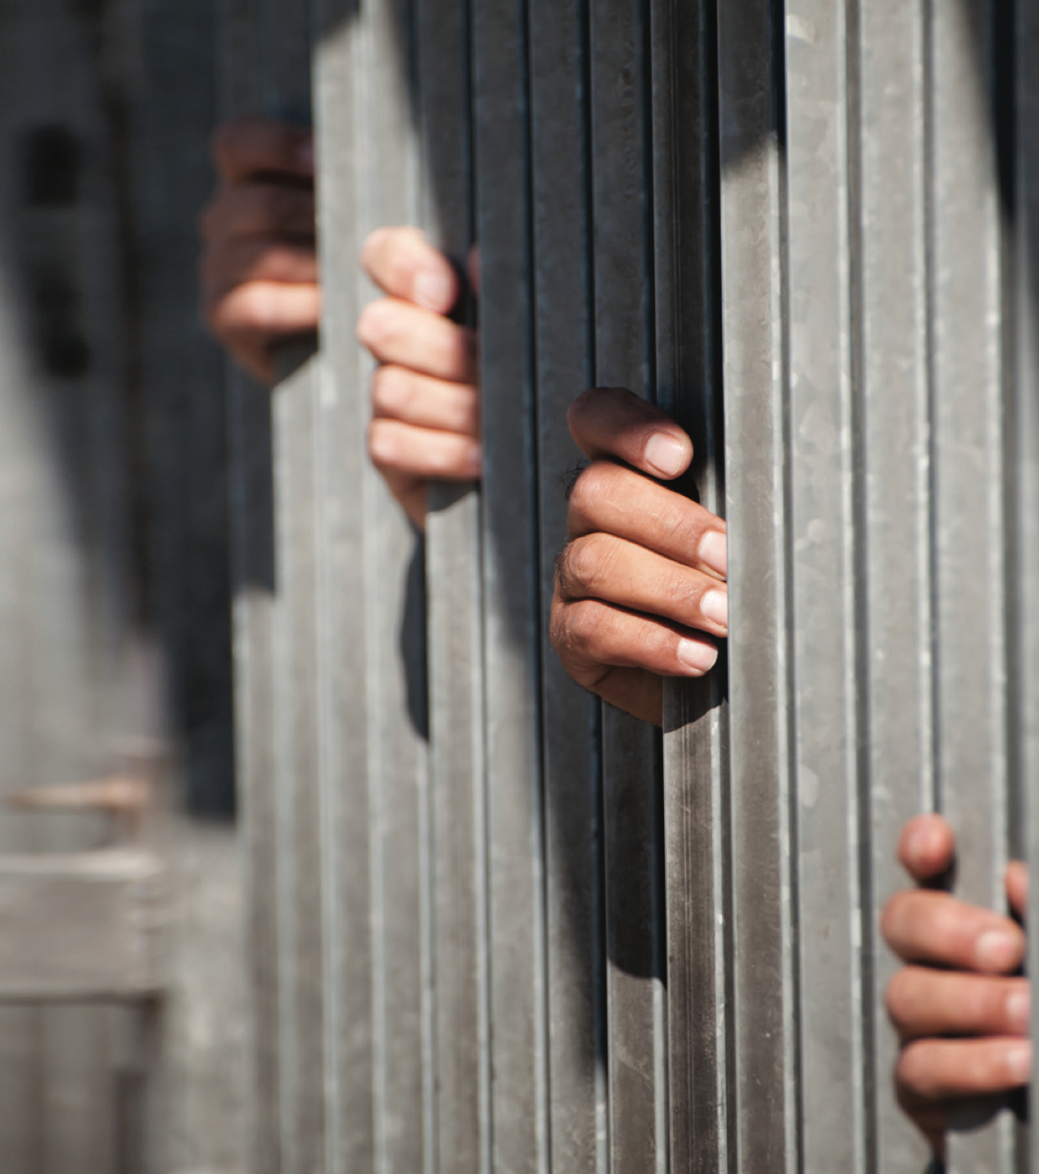
3 Decisive Conditions
Intent to maintain domination by one racial group over another (based on race, creed, or ethnicity)
Notes:
We can break down the understanding of Apartheid into 3 conditions.
We’ll go into each of these conditions as it relates to Israel in detail.
1. Intent to maintain domination by one racial group over another (based on race, creed, or ethnicity)

Slide 5
3 Decisive Conditions
Intent to maintain domination by one racial group over another (based on race, creed, or ethnicity)
Systematic oppression by one group over another.
Notes:
2. Systematic oppression by one group over another.

Slide 6
3 Decisive Conditions
Intent to maintain domination by one racial group over another (based on race, creed, or ethnicity)
Systematic oppression by one group over another.
Human rights violations as part of that oppression
Notes:
3. Human rights violations as part of that oppression
It is clear that Israel fits the conditions of an Apartheid state. Let’s look at them one at a time.

Slide 7
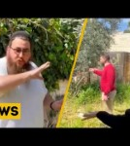
ETHNIC DOMINATION
Official policy of “Judaization” of Jerusalem
Notes:
Looking at the first condition: Ethnic domination. I’ll share just 3 examples of the many of how Israel has long shown an “Intent to maintain domination by one ethnic group over another”
Official Policy of Judaization of Jerusalem
Israel has an official policy stating that the ethnic dynamics of Jerusalem must stay at least 60% Jewish. They term it the “Judiazation of Jerusalem” This discrimination has caused the displacement of Palestinians from their ancestral homes in the city. Israel’s forced displacement of Palestinians from the Sheik Jarrah neighborhood is one famous example. You may remember a viral video clip about it from 2021.

Slide 8
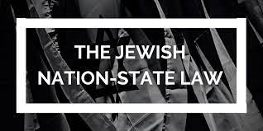
ETHNIC DOMINATION
Official policy of “Judaization” of Jerusalem
Laws that privilege Jewish Israelis
Notes:
Laws that Privilege Jewish Israelis
Adalah Legal Center has a database documenting over 65 laws that discriminate against Palestinian citizens of Israel. https://www.adalah.org/en/law/index
On top of this 2018 Israel passed the Jewish Nation-State law which enshrines Jewish supremacy in Israel’s “basic law.” (similar to a US constitutional amendment) MORE INFORMATION: https://www.adalah.org/en/content/view/9569
This doesn’t even account for the many informal ways in which Palestinians are discriminated against in Israeli society.

Slide 9
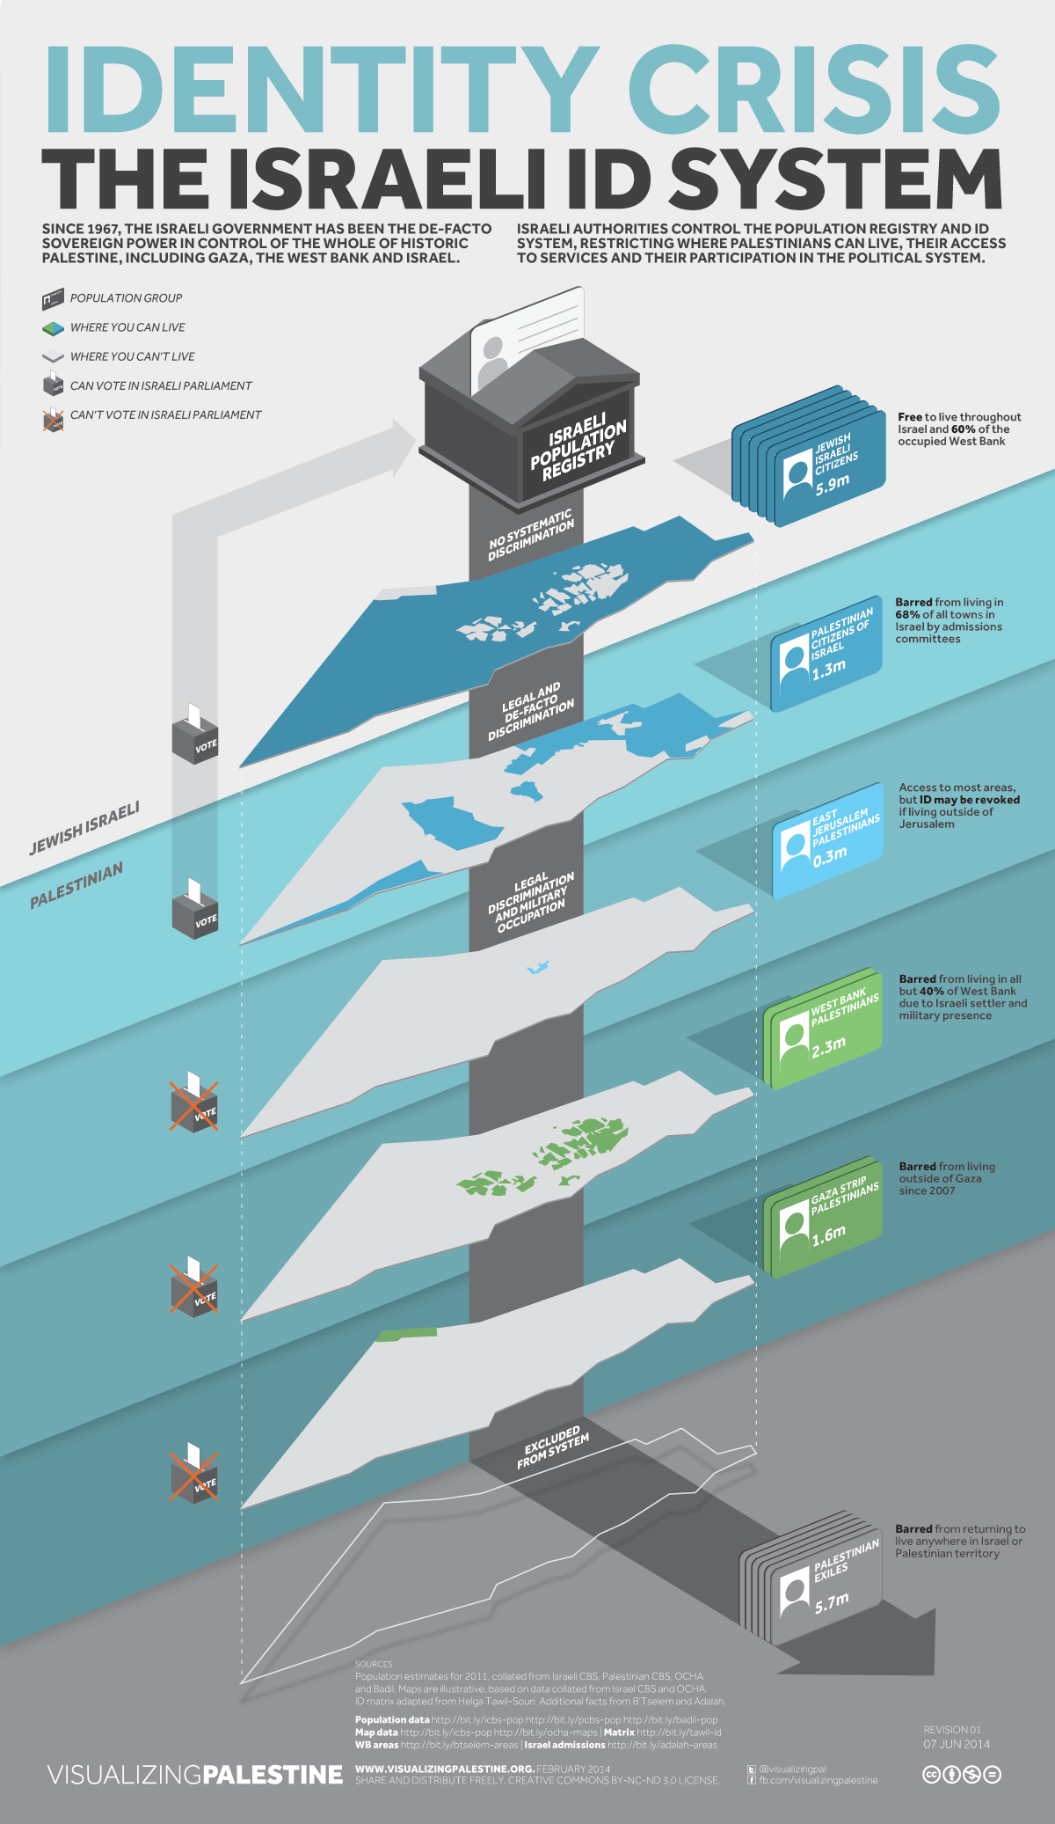
ETHNIC DOMINATION
Official policy of “Judaization” of Jerusalem
Laws that privilege Jewish Israelis
Fragmentation of Palestinian society
Notes:
Fragmentation of Palestinian society
Jews who live under Israeli rule anywhere from the Jordan River to the Mediterranean Sea are treated the same. Palestinians who live in the same areas under Israeli rule are separated from each other between:
Palestinians who live in Israel
Palestinians who live in East Jerusalem
Palestinians who live in Gaza
Palestinians who live in the West Bank
Click the image to enlarge and go into the details of the differences in how Israel treats Palestinians in those areas.

Slide 10
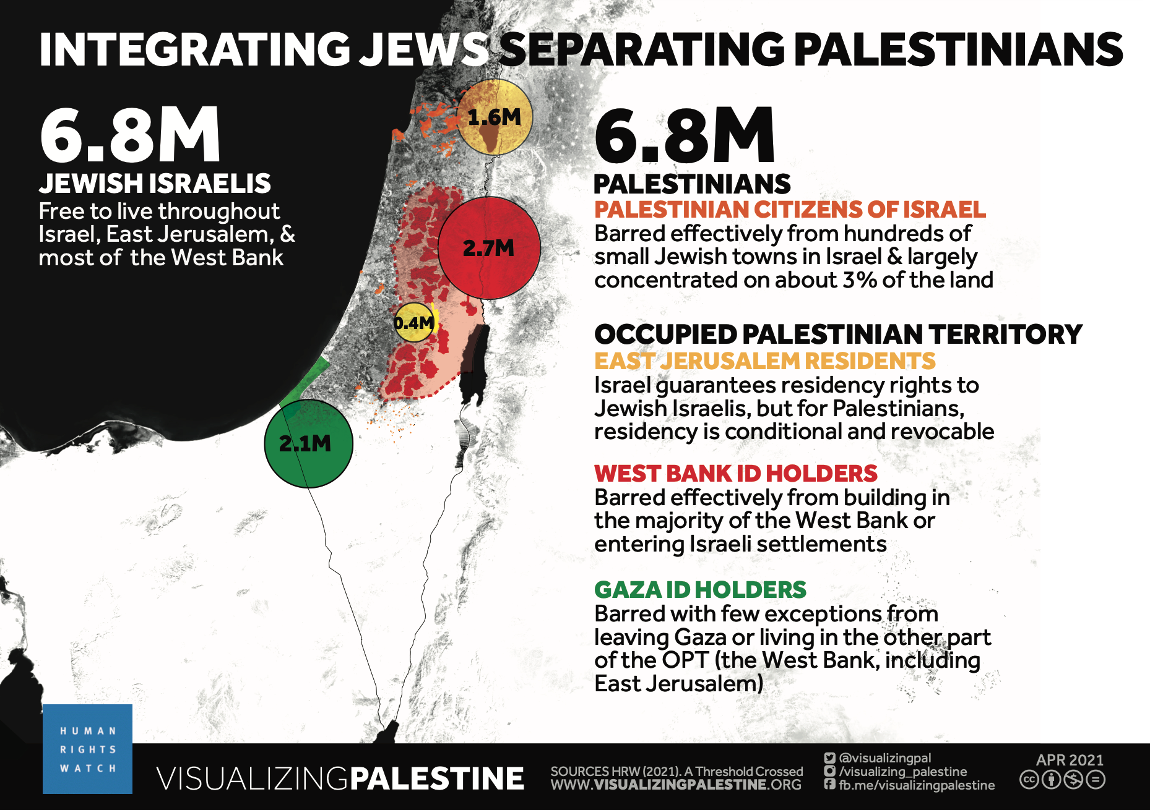
Notes:
Visualizing Palestine worked with Human Rights Watch to create a series of visuals that correspond to the 3 conditions of Aparthied. We include them here as an alternative to text-based slides. Consider reading or describing what you see in the visual. And adding the below points about Israel’s segregation policies.
Human rights watch made their case about Israel’s Ethnic domination by focusing on how Israel integrates Jews while separating Palestinians.
Fragmentation
Palestinians in Israel, and in different part of the occupied East Jerusalem, West Bank, and Gaza all are treated differently and sperated from each other. This graphic does not even mention the millions of Palestinians who are not allowed their internationally recognized “Right of Return” while Israel grants Jews from anywhere in the world citizenship under their declared “law of return.”
An aspect of this separation is Israel’s pervasive permit system
Israel has control over Palestinian’s education, medical care, where to shop or run a business.
Its arbitrary and discriminatory permitting limits Palestinian’s personal freedom, economic development, natural growth of villages/city
For more information on Israel’s use of permits see this article: https://apnews.com/article/7cfac1e5441747da841e51fdf3851460
Limit to housing and development
Israel has enacted a restrictive zoning scheme intended to shrink areas of Israel, East Jerusalem, and especially Area C (comprising 62% of West Bank under full Israeli control) where Palestinians can live and expanding Jewish settlements.
Collective Punishment
Routine punishment of Palestinian cities, neighborhoods and families
Gaza example – 2 million inhabitants punished for acts of a few
Demolishing an alleged perpetrator’s family home
Revoking permits and privileges of a group of people (for example a family) based on the actions of an individual.

Slide 11
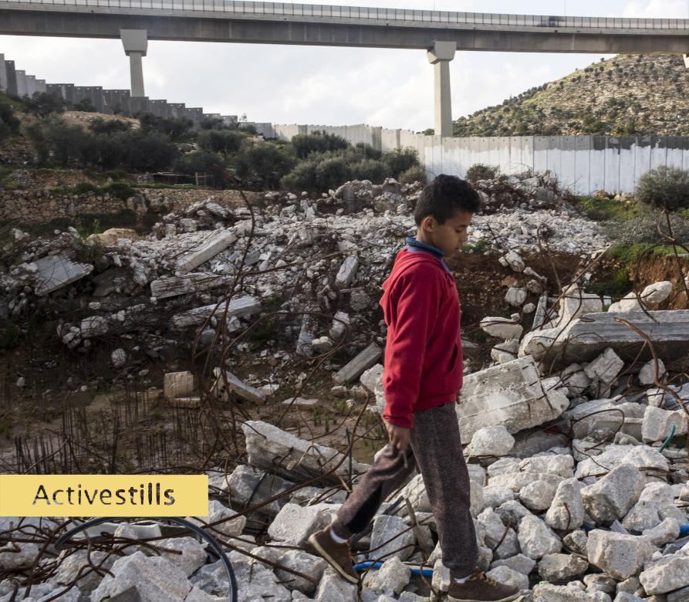
SYSTEMIC OPPRESSION
Two legal systems throughout East Jerusalem and West Bank
Notes:
Two legal systems in East Jerusalem: Israel maintains one set of rules for Jewish Israeli settlers and another for Palestinians in virtually all aspects of life in East Jerusalem. Everything from trash pick up, to public transportation, to sanitation, to parks are segregated and unequal.
In the West Bank Palestinians live under draconian Military Law while Jewish settlers live under civilian law.
Photo: A Palestinian child walks on the remains of a demolished house with the segregation wall and a segregated Israeli only road in the background.

Slide 12
SYSTEMIC OPPRESSION
Two legal systems throughout East Jerusalem and West Bank
No freedom of movement
Notes:
No freedom of movement:
Palestinians’ freedom of movement is restricted in a number of ways.
Israeli “security checkpoints” and road closures
Israeli only highways which cut off segments of the West Bank from other segments.
The wall.
Israel’s permit system that makes Palestinians in the West Bank ask Israeli authorities for access to Jerusalem.
Israeli laws forbidding Israelis (including Palestinians citizens of Israel) from going to the West Bank
The siege on Gaza that hardly allows anyone to enter or leave, treating over 2 million people like prisoners.
Photo: A Palestinian child walks on the remains of a demolished house with the segregation wall and a segregated Israeli only road in the background.

Slide 13
SYSTEMIC OPPRESSION
Two legal systems throughout East Jerusalem and West Bank
No freedom of movement
Discriminatory building permit system
Notes:
Discriminatory building permit system:
In 2020 Israel granted 1,094 building permits to Jewish Israeli, and only 1 to a Palestinian in the West Bank. That same year Israel demolished nearly 1,000 Palestinian structures. According to Amnesty International.
Photo: A Palestinian child walks on the remains of a demolished house with the segregation wall and a segregated Israeli only road in the background.

Slide 14
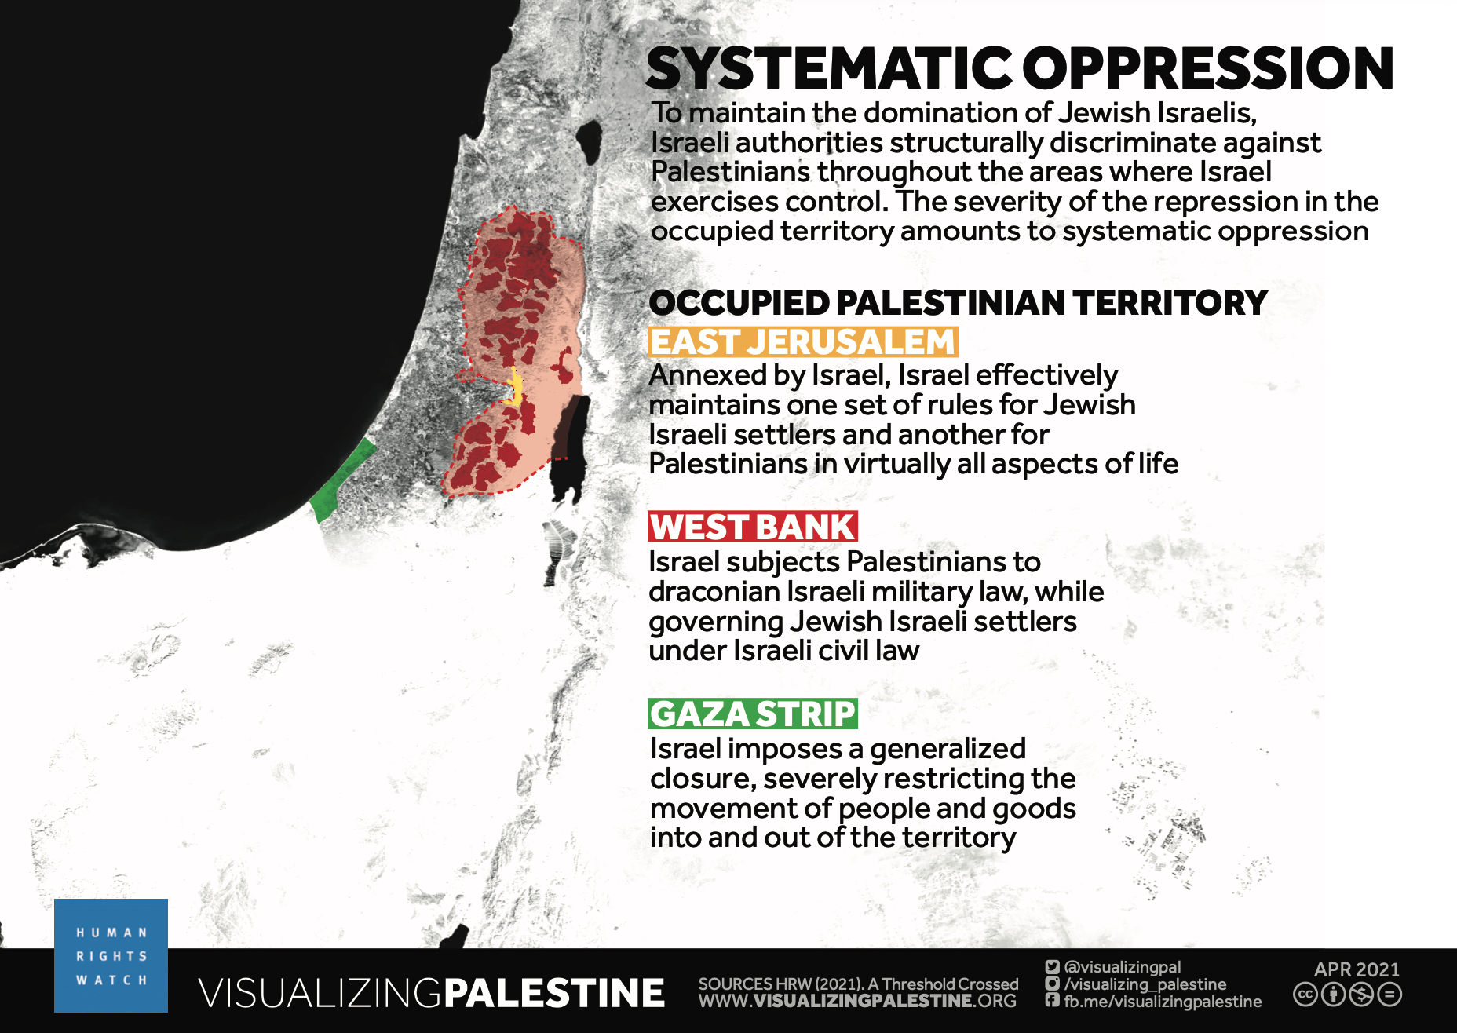
Notes:
Visualizing Palestine worked with Human Rights Watch to create a series of visuals that correspond to the 3 conditions of Aparthied. We include them here as an alternative to text-based slides. Consider reading or describing what you see in the visual.

Slide 15
HUMAN RIGHTS VIOLATIONS
Home demolition, confiscation, and forceable transfer
Denial of residency rights in Jerusalem
Lack of recognition of Bedouin villages
Arrest of Children, and military prosecution
Torture of prisoners
Siege on Gaza
Right of return for refugees
Notes:
HUMAN RIGHTS VIOLATIONS
Inhumane acts, or human rights violations are the third criteria for the crime of apartheid. The list of Israeli human rights violations is too long to recount, or go into detail. Here are just a few examples.
Home demolition, confiscation, and forceable transfer
Denial of residency rights in Jerusalem
Lack of recognition of Bedouin villages
Arrest of Children, and military prosecution
Torture of prisoners
Siege on Gaza
Right of return for refugees

Slide 16
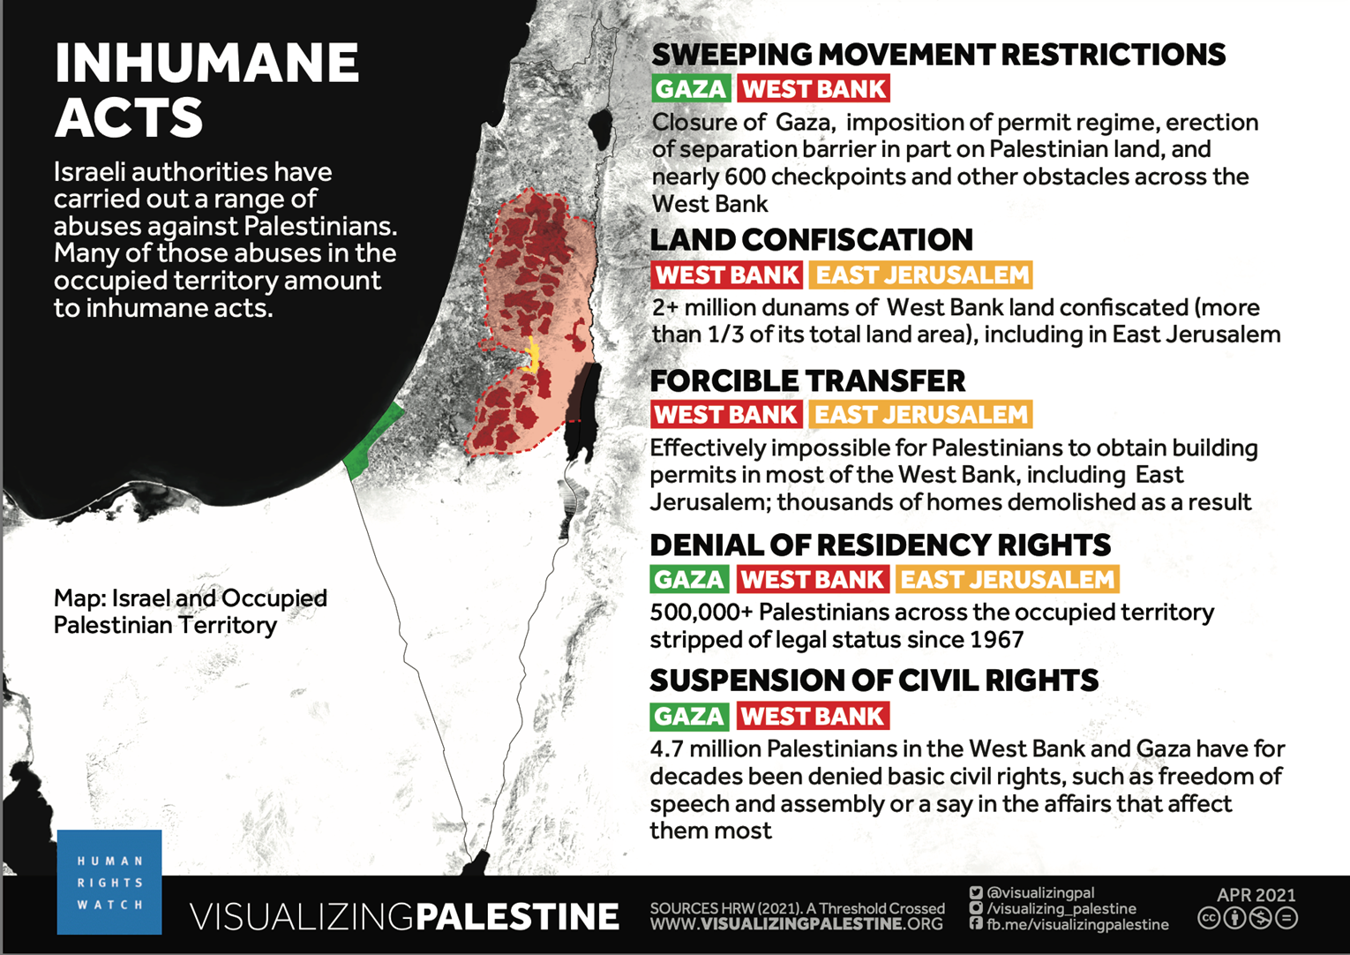
Notes:
Visualizing Palestine worked with Human Rights Watch to create a series of visuals that correspond to the 3 conditions of Aparthied. We include them here as an alternative to text-based slides. Consider reading or describing what you see in the visual.

Slide 17
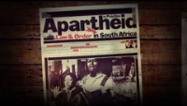
Notes:
Amnesty Long video (15 minutes) details history of Israeli colonization and apartheid

Slide 18
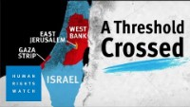
Notes:
Short HRW video focuses on current realities.

Slide 19
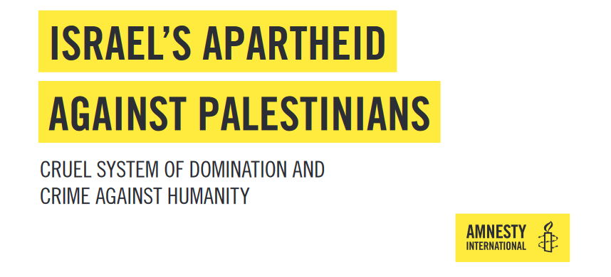
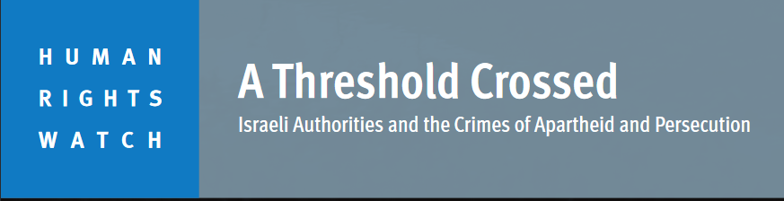

INTERNATIONAL CONSENSUS
Notes:
Israel’s clear violations of the crime of Apartheid have lead to a consensus among human rights organizations Internationally (including in Israel) to name Israeli Apartheid.
Amnesty International
Human Rights Watch
B’Tselem, Israeli Human Rights organization
Are three of the largest organizations. But there are more…

Slide 20
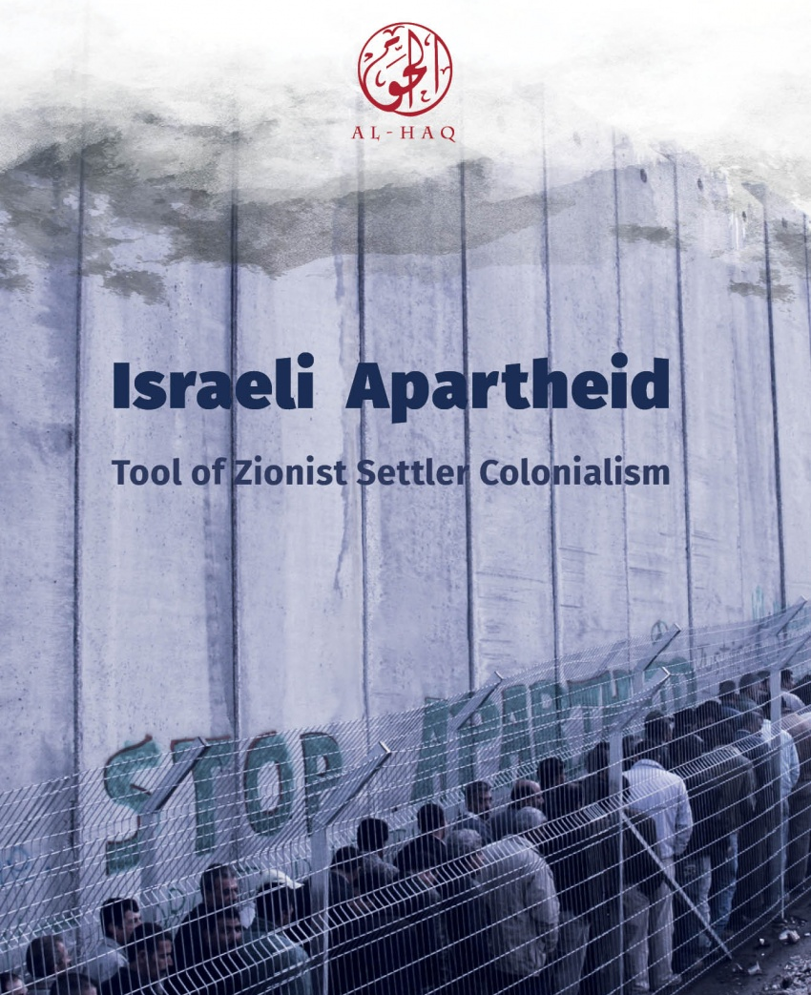
INTERNATIONAL CONSENSUS
Notes:
Palestinian organizations like Al–Haq have come to the same conclusion.

Slide 21
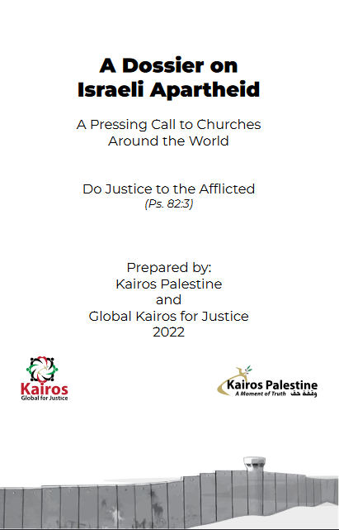
INTERNATIONAL CONSENSUS
Notes:
Christian organizations like Kairos Palestine and Global Kairos for Justice have also named Israeli apartheid.

Slide 22
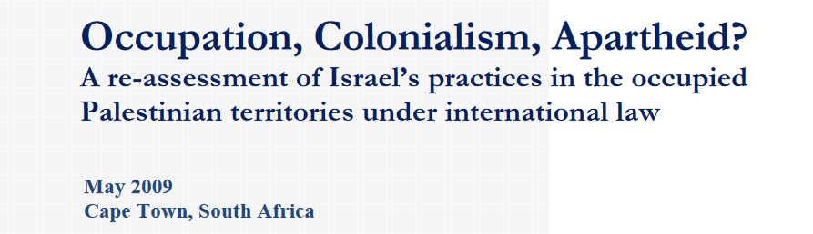
INTERNATIONAL CONSENSUS
Notes:
South African experts, including those who fought apartheid there, like Archbishop Desmond Tutu and Nelson Mandela, have reached the same conclusion.

Slide 23
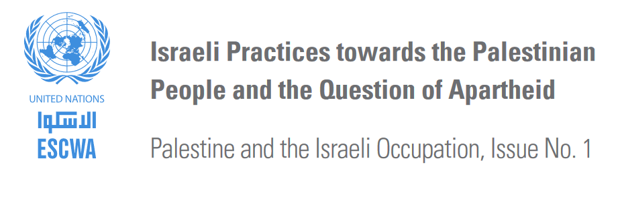
INTERNATIONAL CONSENSUS
Notes:
Even UN agencies have said Israel is an Apartheid state. In short, There is an overwhelming international consensus that Israeli is an Aparthied state.

Slide 24
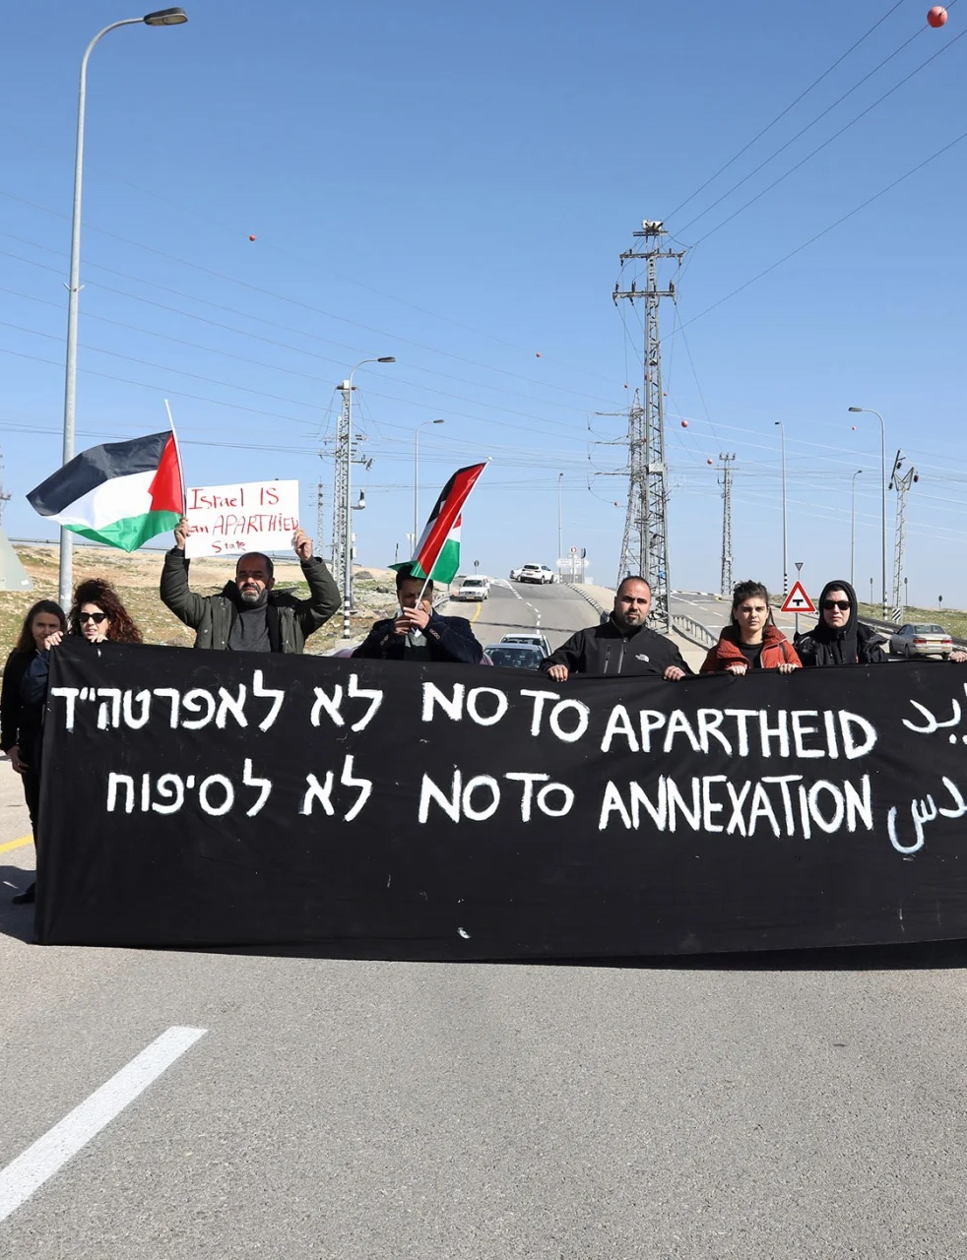
WHAT YOU CAN DO

Slide 25
THE PLEDGE
WE AFFIRM our commitment to freedom, justice, and equality for the Palestinian people and all people;
WE OPPOSE all forms of racism, bigotry, discrimination, and oppression;
WE DECLARE ourselves an Apartheid-Free community,
and to that end;
WE PLEDGE to join others in working to end all support to Israel’s Apartheid regime, settler colonialism, and military occupation.
Notes:
Taking the pledge is an important step in your collective commitment to resisting racism and apartheid.
Whether your community is still learning how to name Israeli apartheid, is already advocating for justice, or
working to end complicity, signing this pledge connects you to a network of communities committed to the
work of justice, freedom, and equality for Palestinians and all people. The prophetic work of challenging
apartheid begins with naming its realities and committing to the work of discerning how to take action.
Living into the Pledge – there are many ways to creatively take action against Israeli apartheid.
Understanding apartheid, changing the narrative, and advocating for change are all important collective
actions that move toward Palestinian liberation. Each community has a different context and is on a
different journey toward addressing the evils of apartheid. In signing this pledge, you commit to
discerning context-specific ways you can take action. You also become part of a growing network of
communities working together to support Palestinians in their quest for self-determination. Here are some
suggestions for your next steps, based on actions that others have already taken.

Slide 26
TAKE ACTION – BECOMING APARTHEID-FREE
Be Creative
Notes:
Be Creative The actions we will discuss are ideas based on what some Apartheid-Free Communities and others have already been doing. But you are the expert on your community and know best what would work in your local context.

Slide 27
TAKE ACTION – BECOMING APARTHEID-FREE
Be Creative
Focus
Notes:
Focus It’s important to focus your efforts to generate the greatest impact. Start small and prioritize. Make a plan for the first few months, then for the year, then beyond. Make plans that make sense for your community.

Slide 28
TAKE ACTION – BECOMING APARTHEID-FREE
Be Creative
Focus
Support is here
Notes:
Support is here The actions we will discuss have already been taken successfully by other communities and organizations. If something looks interesting but you’re not sure how to start, or just have questions, reach out for help.

Slide 29
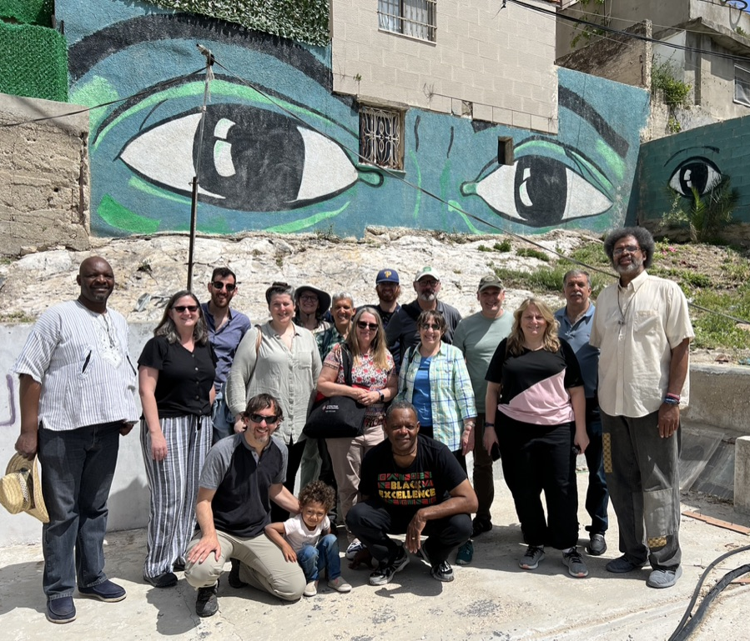
ADVOCACY
Apartheid-Free coalition
Notes:
Join with others in political advocacy, asking the government to withdraw its support of apartheid. Advocacy opportunities include:
Apartheid-Free coalition: Join our existing national faith-based solidarity group that is part of the movement to end US complicity in Apartheid.

Slide 30
ADVOCACY
Apartheid-Free coalition
Americans for Justice in Palestine
Notes:
Americans for Justice in Palestine: This Muslim organization will share campaigns, action alerts, advocacy days, and more on their newsletter to keep you informed on the latest actions.

Slide 31
ADVOCACY
Apartheid-Free coalition
Americans for Justice in Palestine
Jewish Voice for Peace Action
Notes:
Jewish Voice for Peace Action: The lobbying wing of Jewish Voice for Peace also shares campaigns, action alerts, advocacy days, and more on their newsletter to keep you informed on the latest actions.

Slide 32
ADVOCACY
Apartheid-Free coalition
Americans for Justice in Palestine
Jewish Voice for Peace Action
No Way to Treat a Child
Notes:
No Way to Treat a Child: a campaign lobbying for a bill to end the ill-treatment of Palestinian children in the Israeli military detention system The bill is called [HR 3103, Palestinian Children and Families Act]

Slide 33
ADVOCACY
Apartheid-Free coalition
Americans for Justice in Palestine
Jewish Voice for Peace Action
No Way to Treat a Child
US Campaign for Palestinian Rights
Notes:
US Campaign for Palestinian Rights is another important advocacy organization in this movement. They organize campaigns, offer action alerts, toolkits and more, and they mobilize justice advocates for actions throughout the year.

Slide 34

ECONOMIC ACTIVISM
Notes:
Economic activism
Divestment
If your community has investments, use the INVESTIGATE website to screen them for involvements in the occupation. https://investigate.afsc.org/
Organize within your community to ensure it is not invested in apartheid. Start with one company at a time for study and discussion, including Israel Bonds.
Contact the American Friends Service Committee for specialized support on institutional divestment. https://investigate.afsc.org/contact
If your community has already divested from the Israeli occupation, now is a good time to deepen that commitment by divesting from apartheid!

Slide 35
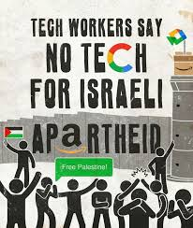
ECONOMIC ACTIVISM
Notes:
Boycotts
There are a number of boycott campaigns currently.
No Tech for Apartheid
Chevron Fuels Genocide
PayPal for Palestine
Eject Energix

Slide 36
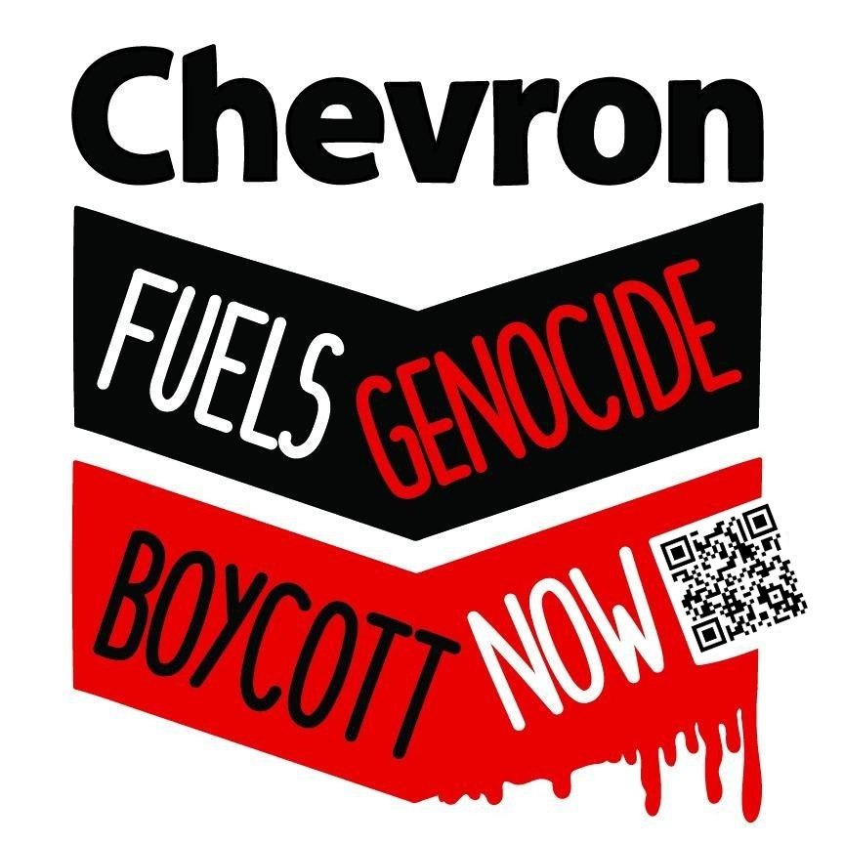
ECONOMIC ACTIVISM
Notes:
Boycotts
There are a number of boycott campaigs currently.
No Tech for Apartheid
Chevron Fuels Genocide
PayPal for Palestine
Eject Energix

Slide 37

ECONOMIC ACTIVISM
Notes:
Boycotts
There are a number of boycott campaigs currently.
No Tech for Apartheid
Chevron Fuels Genocide
PayPal for Palestine
Eject Energix

Slide 38
JOIN THE GROWING NUMBER OF SIGNERS!
Over 335 organizations have taken the pledge!
Notes:
I hope your community will consider signing the pledge. And being part of this growing network

Slide 39
JOIN THE GROWING NUMBER OF SIGNERS!
Over 335 organizations have taken the pledge!
Signers include Buddhist, Christian, Jewish, Muslim, and Interfaith congregations and organizations
Notes:
This is truly an interfaith initiative.

Slide 40
JOIN THE GROWING NUMBER OF SIGNERS!
Over 335 organizations have taken the pledge!
Signers include Buddhist, Christian, Jewish, Muslim, and Interfaith congregations and organizations
Secular and community groups
Notes:
It has expanded to include secular and community groups.

Slide 41
JOIN THE GROWING NUMBER OF SIGNERS!
Over 335 organizations have taken the pledge!
Signers include Buddhist, Christian, Jewish, Muslim, and Interfaith congregations and organizations
Secular and community groups
International groups
Notes:
Even international organizations have taken the pledge.

Slide 42

Questions
?

Slide 43
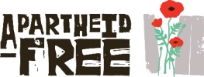
Thank
You!
Questions? Contact us:
info@apartheid-free.org
apartheid-free.org

